Slide 1
AWS Serverless Image Classifier
Using AWS Lambda and Amazon Rekognition
Shivam Sinha

Slide 2
Overview
The objective of this project is to automate the process of analyzing images using AWS services. The goal is to classify images based on their content and organize them into appropriate folders (success or failure) for further review. The process begins when images are uploaded to an S3 bucket, which serves as the storage for input images. Upon uploading, an SQS queue is triggered, notifying the system of new images that need to be analyzed. AWS Rekognition is then used to analyze the images and detect specific objects, such as "Football."
The Rekognition service provides labels and confidence scores for each object detected in the image. Based on these labels, a Lambda function categorizes the image as either successful (if the required labels are found) or failed (if the required labels are absent) and moves the image to the respective folder within the S3 bucket. This system streamlines the process of image analysis, making it more efficient and automated.

Slide 3
Understanding the problem
Goal
We want to automatically analyze images and categorize them based on their content using a series of AWS tools.
Automation: We need to automate the entire process so we don’t have to manually sort images.
Handling Errors: If something goes wrong with the analysis, we need a way to catch and handle those errors properly.
Challenge
Result
This system will allow us to automatically organize and analyze images as soon as they are uploaded, making the process faster and reducing human effort

Slide 4
Architecture Overview
Architecture Components:
S3 Bucket: Stores images and the categorized results.
SQS Queue: Receives notifications of new image uploads.
Lambda Function: Analyzes images using AWS Rekognition, moves the image to the correct folder (success or failure), and logs the results.
AWS Rekognition: Detects objects in the images.
Flow:
Image uploaded to S3 bucket.
S3 triggers an event, sending a notification to SQS.
Lambda function processes the SQS message, analyzes the image, and categorizes it.
Image is moved to the appropriate folder in S3 (success or failure).

Slide 5
Setup Overview
S3 Bucket Setup:
Bucket Name: widget-inspection-images
Folders: /images (input), /analyzed (subfolders: /success, /failure)
Event Notification: Trigger SQS on PUT events for image uploads
SQS Queue Setup:
Queue Name: image-analysis-queue
Access Policy: Grant S3 permission to publish to the queue
Dead-Letter Queue: image-analysis-dlq for failed messages
AWS Rekognition:
Purpose: Detect specific labels (e.g., "Football", "Widget") in images
Integration: Lambda function invokes Rekognition to analyze S3 images
Lambda Function Setup:
Role: Analyzes images, categorizes, and moves them to /success or /failure
Permissions: S3 (read/write), Rekognition (read), CloudWatch (logs), SQS (read)

Slide 6
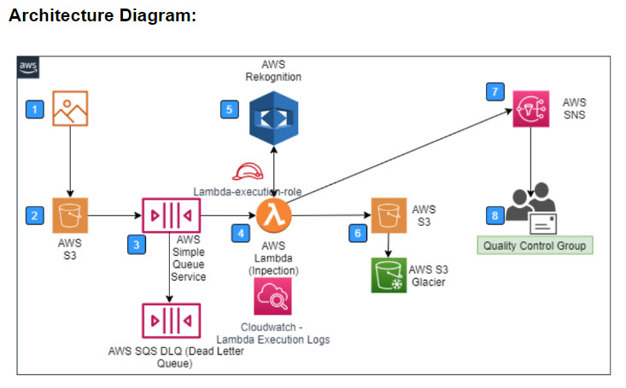
Detailed Architecture Diagram

Slide 7
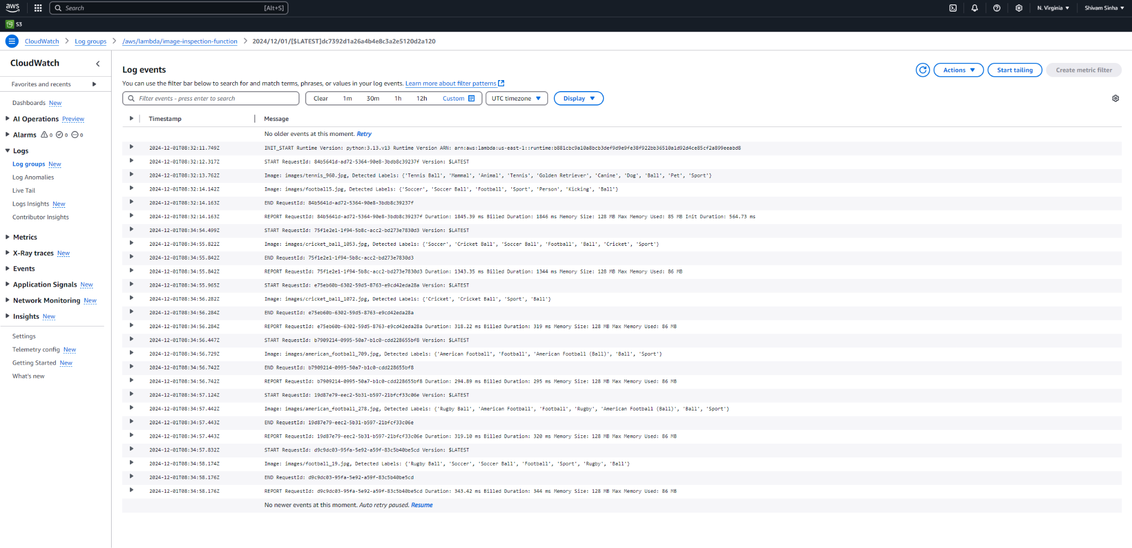
CloudWatch Logs
CloudWatch Logs plays a crucial role in monitoring the execution of the Lambda function and tracking application behavior. It captures detailed logs of image processing events, such as S3 object analysis, detected labels, and file movement. These logs are essential for troubleshooting errors, ensuring smooth operation, and providing insights into the system's performance. By centralizing logs, CloudWatch helps the support team maintain application reliability and security while enabling quick issue resolution

Slide 8
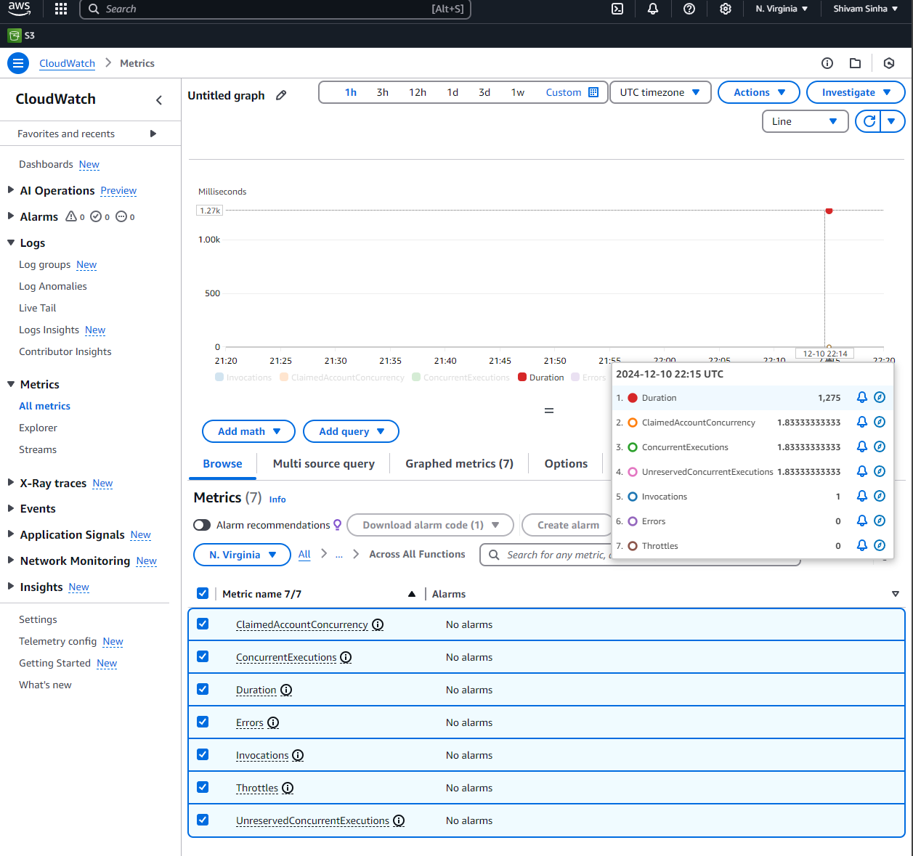
CloudWatch metrics

Slide 9
Challenges and Solutions
Challenge 1: Ensuring the Lambda function processes only images.
Solution: Filter events based on file extensions (e.g., .jpg, .png).
Challenge 2: Handling failed image processing.
Solution: Use the Dead-Letter Queue for failed messages.
Challenge 3: Label detection accuracy.
Solution: Use high-confidence thresholds in Rekognition to ensure accurate results.

Slide 10
Future Improvements
Multiple Label Detection: Extend the system to detect more complex or multiple labels (e.g., “Football”, “Soccer”, etc.).
Scale the System: Add additional S3 buckets or Rekognition usage for higher throughput.
Integrate with Other AWS Services: Use SNS for alerting or DynamoDB for storing analysis results.

Slide 11
Thank you!

